Slide 1

AGRICULTURE ACADEMY
FACULTY OF BIOECONOMY DEVELOPMENT
Department..........................................
TITLE OF PRESENTATION
(For example, Presentation of Bachelor's / Master's thesis)
Name SURNAME
Akademija, date

Slide 2


STRUCTURE OF PRESENTATION
Basic concepts
Components of the research methodology
Quantitative and qualitative research methods
Preparation for the research, its organization and the course of the research
Selection
Research ethics
2

Slide 3
INTRODUCTION
Each student studying at the Faculty of Bioeconomy Development must perform the independent work provided in the Bachelor's and Master's study programs - individual, group assignments, reports, term papers, prepare internship reports, and upon completion of studies - bachelor's and master's thesis.
The aim of this methodological tool is to provide the main methodological, work content, formalization, work presentation instructions applicable to the works prepared by the students of the Faculty of Bioeconomy Development of Vytautas Magnus University, Academy of Agriculture.
3

Slide 4
Table 1. Structure and content requirements of the innovation practice report
Components | Content requirements
Introduction | The introduction indicates the place, goal and objectives of innovation practice, applied research methods.
Analytical descriptive part | This section describes the company, institution or other organization where innovation practice is carried out (hereinafter referred to as the organization), describes its achievements and indicators, reveals the organisation's innovation activities and management experience and problems, analyzes implemented innovations and their nature, investments and their financing sources, the expediency of the implemented innovations is assessed and economic, social and environmental effects are created, innovations important for the further strategic development of the organization are theoretically and practically substantiated. The individual statements of the report are illustrated by the documents collected during the internship, statistical data, the results of interviews with the managers of the organization, other employees, and so on.
Conclusions | Using the material of the analytical descriptive part, the conclusions describe the innovativeness of the organization, the ability to purposefully select innovations and manage their implementation processes, to link them with the strategic development of the organization, the effectiveness of implemented innovations.
4

Slide 5
Fig. 1. Ratio of rural and urban population in Vilkaviškis district municipality in 2014-2018, percent (compiled by the author according to the information of the Department of Statistics, 2018)
5

Slide 6


Fig. 2. Ratio of rural and urban population in Vilkaviškis district municipality in 2014-2018, percent (compiled by the author according to the information of the Department of Statistics, 2018)
6

Slide 7
Part name (eg Test results)
The name of the longer text slide
Only at this university:
You will create a personal study plan that meets your needs, in which you will be able to include the subjects of the parallel study program providing a double qualification;
You will gain international experience by choosing from more than 300 foreign universities and research centers, where 30 taught world languages will help you to communicate;
After seeing the performances of the first professional university theater in Lithuania and hearing the chords of the performers of the Academy of Music, you will feel how you become an integral part of Kaunas cultural life.
7

Slide 8
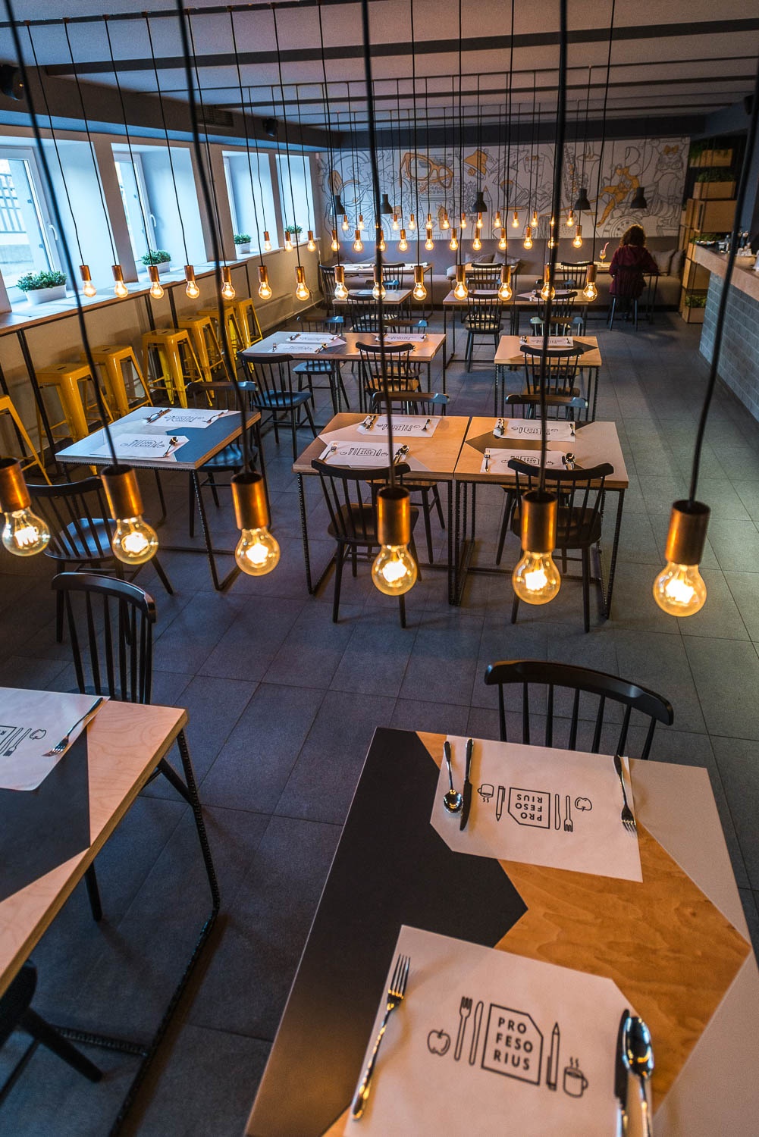
Part name (eg Research results)
The name of the text slides
Recognized as one of the 700 best universities in the world, VMU is the only one in the country to offer studies based on the principles of artes liberales.
39 bachelor's (3 of them in English), 52 master's (15 of them in English), 15 postgraduate study programs, integrated law studies and 18 doctoral studies are waiting for you in ten faculties.
Fig. 3. Title
8

Slide 9
Part name (eg Test results)
The name of the text slides
Recognized as one of the 700 best universities in the world, VMU is the only one in the country to offer studies based on the principles of artes liberales.
39 bachelor's (3 of them in English), 52 master's (15 of them in English), 15 postgraduate study programs, integrated law studies and 18 doctoral studies are waiting for you in ten faculties.
Fig. 4. Title
9

Slide 10
Thank You for attention!

